Slide 1
Pooling-Based Vision Transformer (PiT) for Enhanced Plant Disease Classification
Siva Adduri g00095118 Mohamed Alkhaja Alawadhi b00094286 Arya Sankhe b00097405 Hamza Khan b00092525

Slide 2
Introduction
Opening Perspective:
Critical Importance: Plant diseases pose a significant threat to global food security, causing 20-40% losses in annual food production (FAO).
Global Relevance: With a growing population expected to reach 9.7 billion by 2050, ensuring healthy crops is crucial for sustainable agriculture.
The Challenge:
Traditional Methods: Detection relies on manual inspection, which is:
Labour-intensive and time-consuming.
Prone to human error and variability in expertise.
Scale of the Problem: Large-scale farms and diverse disease symptoms make manual detection inefficient and often ineffective.
Need for Automation: A robust, scalable, and accurate solution is essential to meet the growing demand for food while minimizing losses.

Slide 3
Problem Statement
Traditional plant disease detection methods are inefficient, labor-intensive, and prone to human error, making them unsuitable for addressing the scale and complexity of modern agriculture. There is an urgent need for an automated, accurate, and scalable solution to detect plant diseases early, reduce crop losses, and enhance food security for a growing global population.

Slide 4
Literature Review
Rethinking Spatial Dimensions of Vision Transformers Authors: B. Heo, S. Yun, D. Han, S. Chun, J. Choe, & S. J. Oh. Conference: Published on arXiv, accepted to ICCV 2021.
Visual Intelligence in Precision Agriculture: A Deep Dive into Plant Disease Detection Using Efficient Vision Transformers Authors: S. Parez, N. Dilshad, N. S. Alghamdi, T. M. Alanazi, & J. W. Lee. Conference: Published in Sensors journal, a prominent venue for studies on precision agriculture and machine vision.
Explainable Vision Transformer Enabled Convolutional Neural Network for Plant Disease Identification Authors: P. S. Thakur, P. Khanna, T. Sheorey, & A. Ojha. Conference: Published on arXiv, focusing on explainable AI in plant disease identification.

Slide 5
Literature Review
Rethinking Spatial Dimensions of Vision Transformers
Introduces Pooling-based Vision Transformer (PiT), improving computational efficiency, speed, and robustness.
Combines pooling layers and depth-wise convolution to handle challenging inputs and limited data.
Achieves state-of-the-art performance with fewer resources.
Visual Intelligence in Precision Agriculture
Proposes GreenViT, optimized for plant disease detection with high accuracy (100%, 98%, 99%) and reduced parameters (85M to 21.65M).
Outperforms models with a low False Alarm Rate, proving effective for precision agriculture.
Explainable Vision Transformer for Plant Disease Identification
Combines CNNs (local features) and ViTs (global dependencies) in PlantXViT for accurate and interpretable detection.
Achieves 93.55%-98.86% accuracy and uses tools like Grad-CAM and LIME for explainability.

Slide 6
Methodology
Dataset Preparation:
Use the Plant Village dataset with 29 classes, reorganized for usability.
The dataset already includes data augmentation, such as rotation, flipping, and scaling, ensuring diversity.
Model Setup:
Load the following models:
PiT (Pooling-based Vision Transformer) using the timm library.
ResNet and Vision Transformer (ViT) for benchmarking performance and comparative analysis.
All models are fine-tuned for 29 output classes.
Optimizer: AdamW, Loss: CrossEntropyLoss, Batch size: 32, Epochs: 10.
Training: Train all models and record training and validation metrics for comparison.
Evaluation:
Generate a classification report (Precision, Recall, F1-Score) for each model.
Visualize results using a confusion matrix and sample predictions for each.
Performance Metrics:
Compare training, validation, and testing accuracies across PiT, ResNet, and ViT.
Analyze FLOPs, parameter count, and inference speed (GPU/CPU) for all models.
Visualizations: Highlight correct and misclassified predictions for each model with confidence scores.
Model Statistics: Measure and compare FLOPs, trainable parameters, and inference speed for all models.

Slide 7
Implementation
1. Dataset Preparation
Dataset: Plant Village dataset loaded from Kaggle.
Reorganization:
Used the function rename_and_merge(source_path, destination_path) to:
Rename and merge plant disease classes into folders (e.g., Apple_Healthy, Tomato_Late_Blight).
Split into Train, Val, and Test directories.
Transformations:
Applied transformations in torchvision.transforms.Compose:
Resize images to 224x224 pixels.
Normalize with mean [0.485, 0.456, 0.406] and std [0.229, 0.224, 0.225].
Dataset loaded using torchvision.datasets.ImageFolder and passed into DataLoader for batching.

Slide 8
Implementation
2. Model Setup
Pre-trained Models:
PiT: Loaded with timm.create_model('pit_s_224', pretrained=True, num_classes=29).
ResNet and ViT: Similarly loaded using the timm library for benchmarking.
Training Configuration:
Loss Function: torch.nn.CrossEntropyLoss().
Optimizer: torch.optim.AdamW(model.parameters(), lr=0.001).

Slide 9
Implementation
2. Model Setup
b. PiT ViT model
a. ResNet model
c. ViT model
Layer Name | Description
Positional Embedding | pos_embed: Adds positional information with shape (1,144,27,27).
Class Token | cls_token: A learnable token for global feature aggregation, shape (1,1,144).
Patch Embedding | patch_embed.conv: Convolution-based embedding of patches into 144 dimensions.
 | - patch_embed.conv.weight: (144,3,16,16), processes RGB input.
 | - patch_embed.conv.bias: (144,).
Transformer Blocks | Consists of multiple blocks for feature processing and pooling.
 | - Block 0 (transformers.0.blocks): ∼0.5M parameters.
 | - Block 1 (transformers.1.blocks): ∼6.0M parameters.
 | - Includes transformers.1.pool for downsampling (∼44.6K).
 | - Block 2 (transformers.2.blocks): ∼16.0M parameters.
 | - Includes transformers.2.pool for further downsampling (∼0.2M).
Normalization Layer | norm: Final normalization layer before classification.
 | - norm.weight: (576,).
 | - norm.bias: (576,).
Classification Head | head: Fully connected layer for classification.
 | - head.weight: Maps the final output to 29 classes ((29,576)).
 | - head.bias: Adds bias to predictions ((29,)).
Layer Name | Description
Conv1 (conv1) | Initial convolutional layer, filters the input image.
 | - conv1.weight: (64,3,7,7), learns initial feature maps.
BatchNorm1 (bn1) | Batch normalization layer after conv1.
 | - bn1.weight: (64,).
 | - bn1.bias: (64,).
Layer 1 (layer1) | First residual block containing multiple sub-blocks.
 | - Sub-block 0 (layer1.0): ∼75.0K parameters.
 | - layer1.0.conv1: (4.1K), processes features.
 | - layer1.0.bn1: (0.1K), normalization.
 | - layer1.0.conv2: (36.9K), deepens feature extraction.
 | - layer1.0.bn2: (0.1K), normalization.
 | - layer1.0.conv3: (16.4K), adds depth.
 | - layer1.0.downsample: (16.9K), matches feature map sizes.
 | - Sub-block 1 (layer1.1): ∼70.4K parameters.
 | - Similar structure to layer1.0 with additional layers.
Layer 2-4 | Deeper residual blocks, increasing feature depth and abstraction.
 | - layer4.2.bn3: Batch normalization for the final block.
Fully Connected (fc) | Final classification layer.
 | - fc.weight: Maps 2048-dimensional features to 29 classes (29,2048).
 | - fc.bias: Adds bias to class predictions (29,).
Layer Name | Description
Input Layer | Splits input image into non-overlapping patches of size 16×16.
Patch Embedding | patch_embed.proj: Linear projection of patches into 768-dimensional vectors.
Positional Embedding | pos_embed: Adds positional information to patch embeddings.
Class Token | cls_token: A learnable token for global feature aggregation.
Transformer Encoder | 12 identical blocks, each containing:
 | - norm1: Layer normalization for attention input.
 | - attn: Multi-head self-attention for feature relationships.
 | - norm2: Layer normalization for MLP input.
 | - mlp: Feed-forward network with linear layers and GELU activation.
Normalization Layer | norm: Final normalization of Transformer outputs.
Classification Head | head: Fully connected layer mapping the [CLS] token to class probabilities.

Slide 10
Implementation
3. Training the Model
Function: train_and_validate(model, train_loader, val_loader, criterion, optimizer, epochs=10).
Executes training loop for 10 epochs.
Tracks:
Training Loss and Accuracy for each batch.
Validation Loss and Accuracy after each epoch.
4. Evaluation
Function: evaluate_model(model, test_loader).
Generates a classification report (Precision, Recall, F1-Score) using sklearn.metrics.classification_report using the test data.
Plots a confusion matrix with Seaborn:

Slide 11
Implementation
5. Visualization
Correct and Incorrect Predictions:
Functions:
display_examples(images, labels, preds, indices, class_names, title): Displays sample predictions.
display_diverse_examples(images, labels, preds, indices, class_names, title): Displays diverse correct/incorrect predictions.

Slide 12
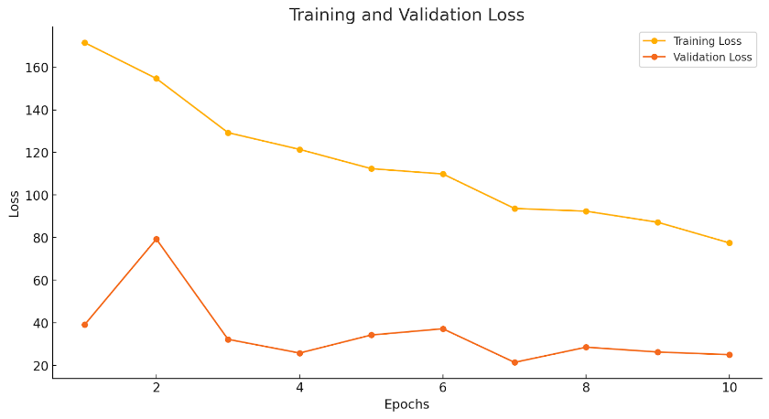
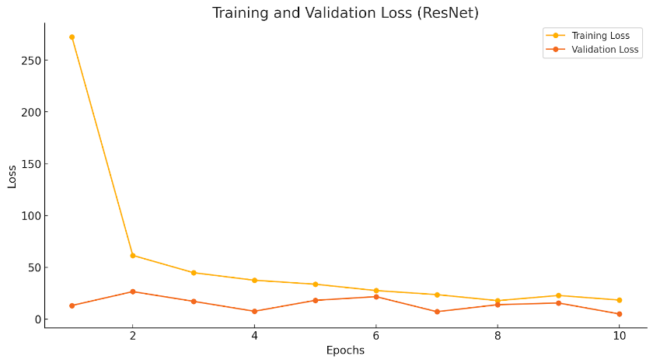
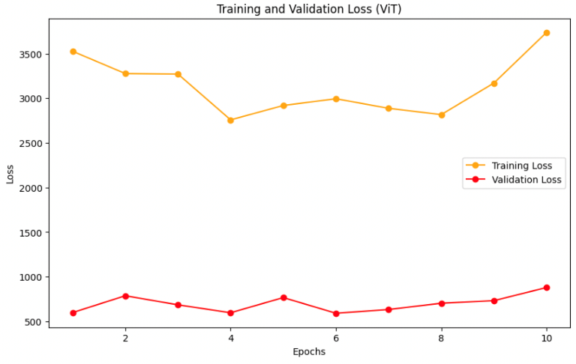
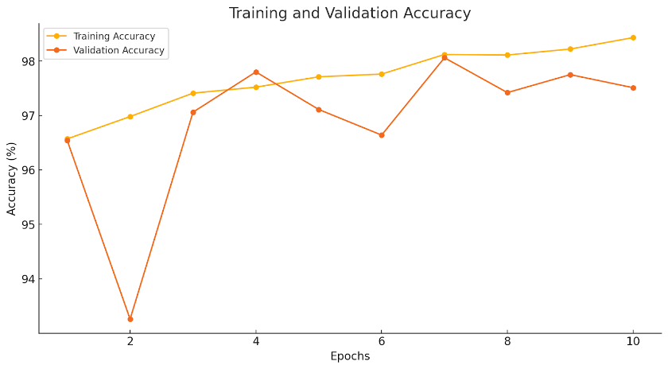
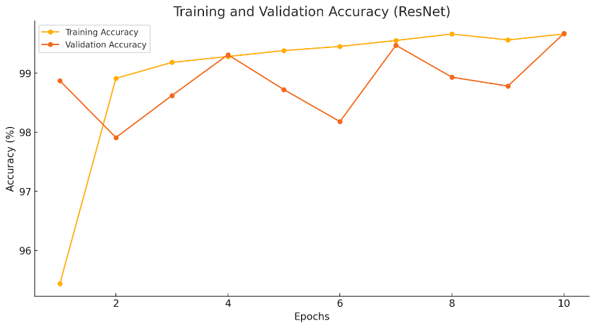
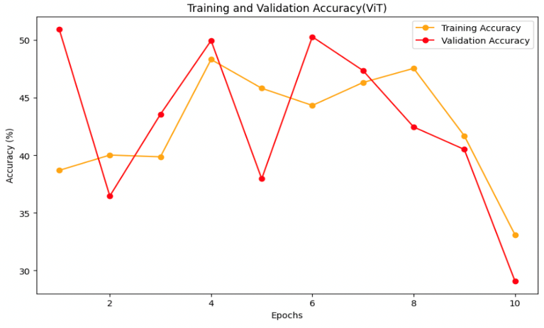
Your Results
1. Training and Validation Loss and Accuracy
a. PiT ViT model
b. ResNet model
c. ViT model

Slide 13
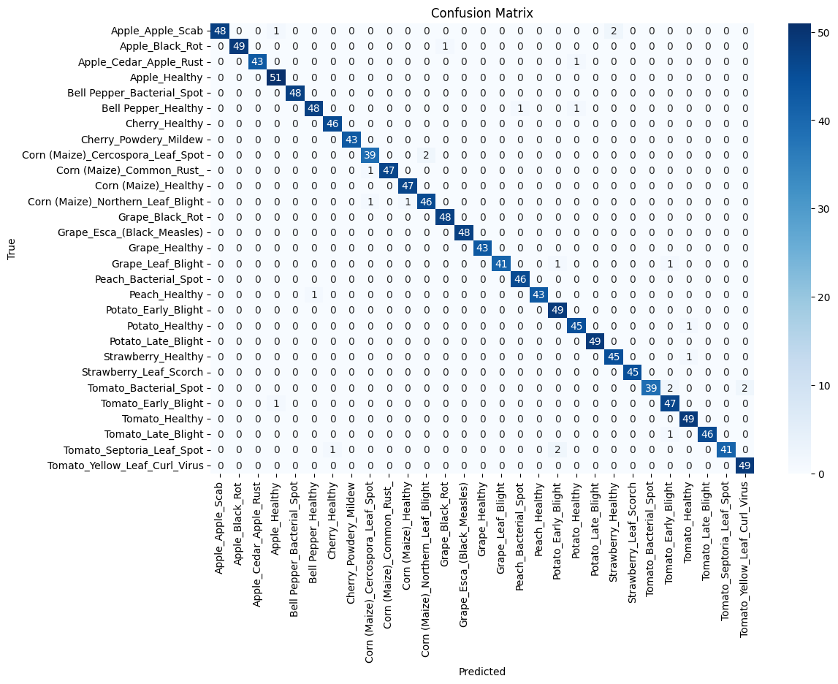

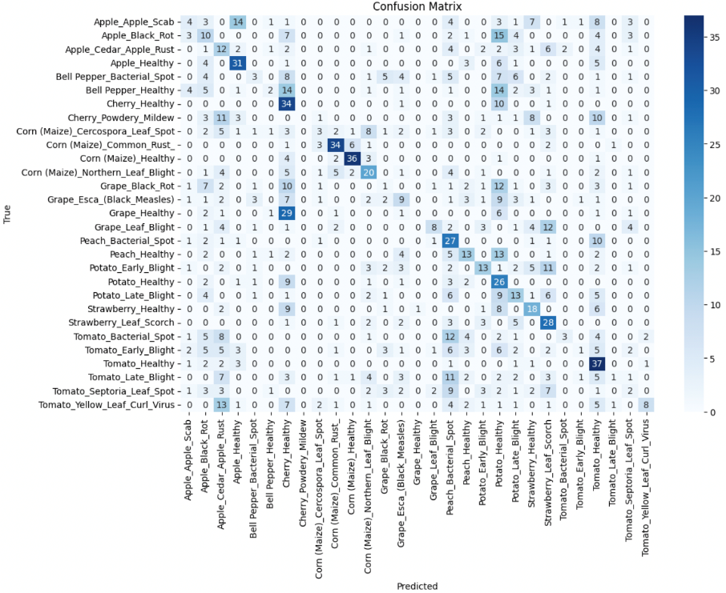
Your Results
2. Confusion Matrix
a. PiT ViT model
b. ResNet model
c. ViT model

Slide 14
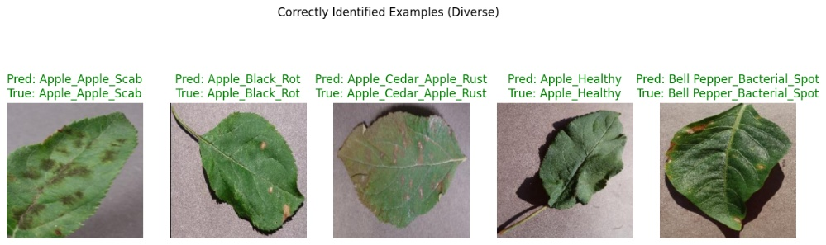
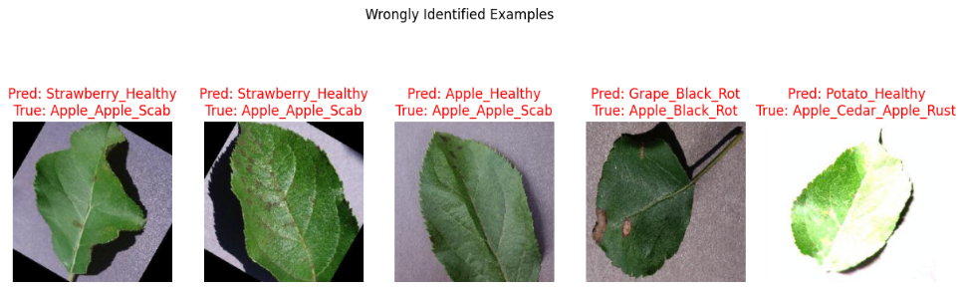
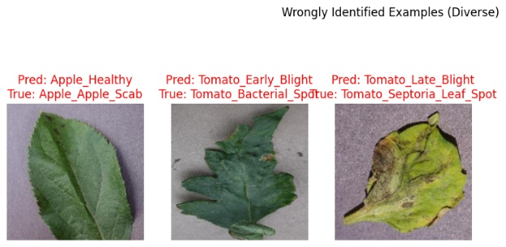
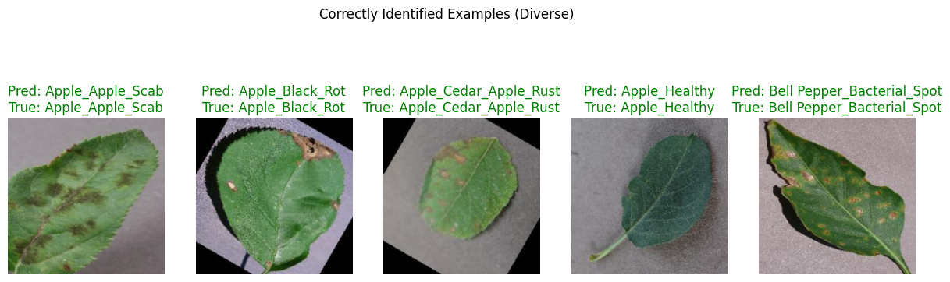
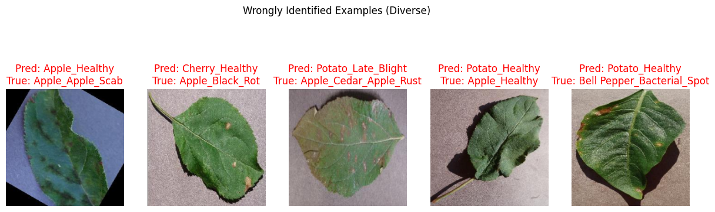
Your Results
3. Visualization of Output
a. PiT ViT model
b. ResNet model
c. ViT model

Slide 15
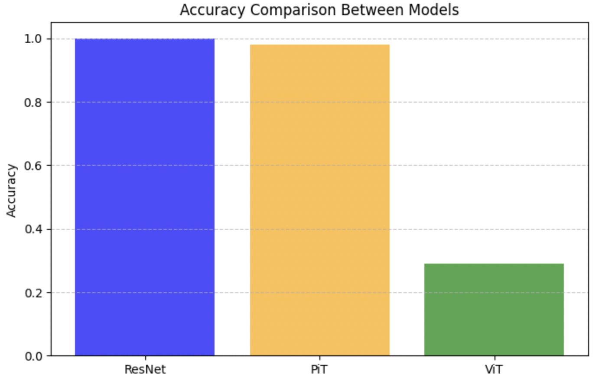
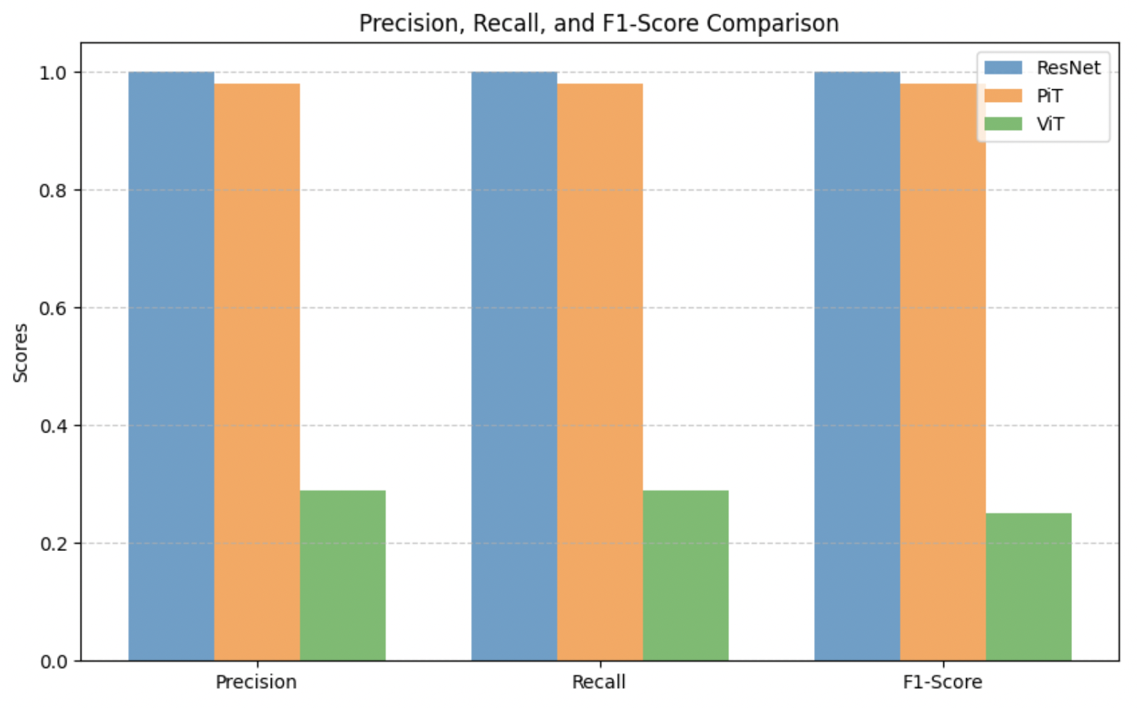
Performance evaluation
1. Accuracy between the three models

Slide 16
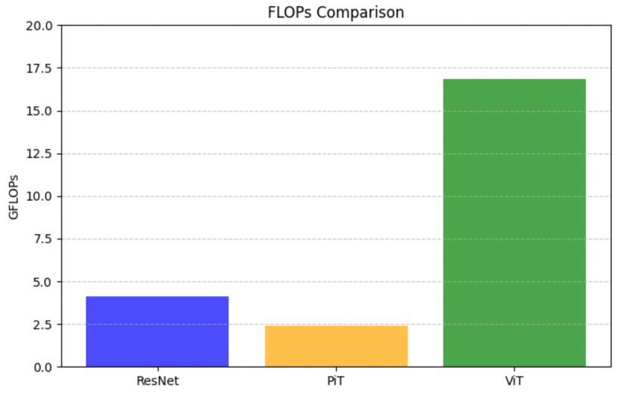
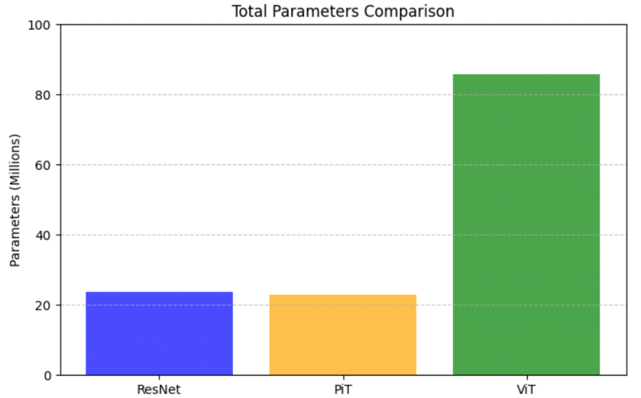
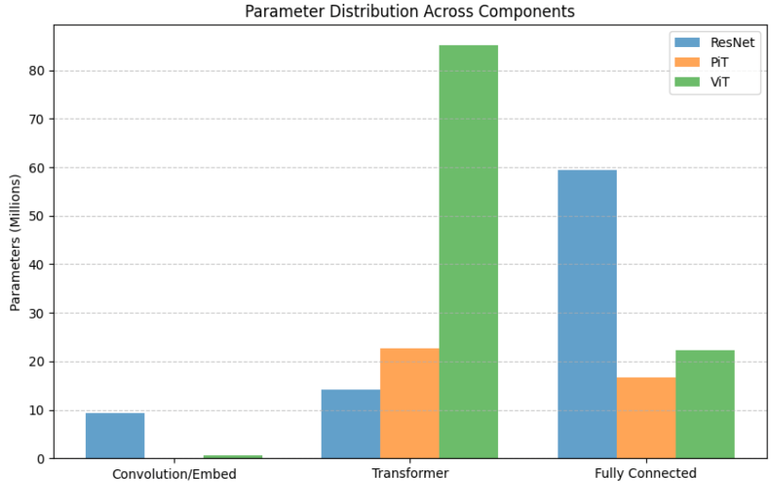
Performance evaluation
2. Memory Comparisons

Slide 17
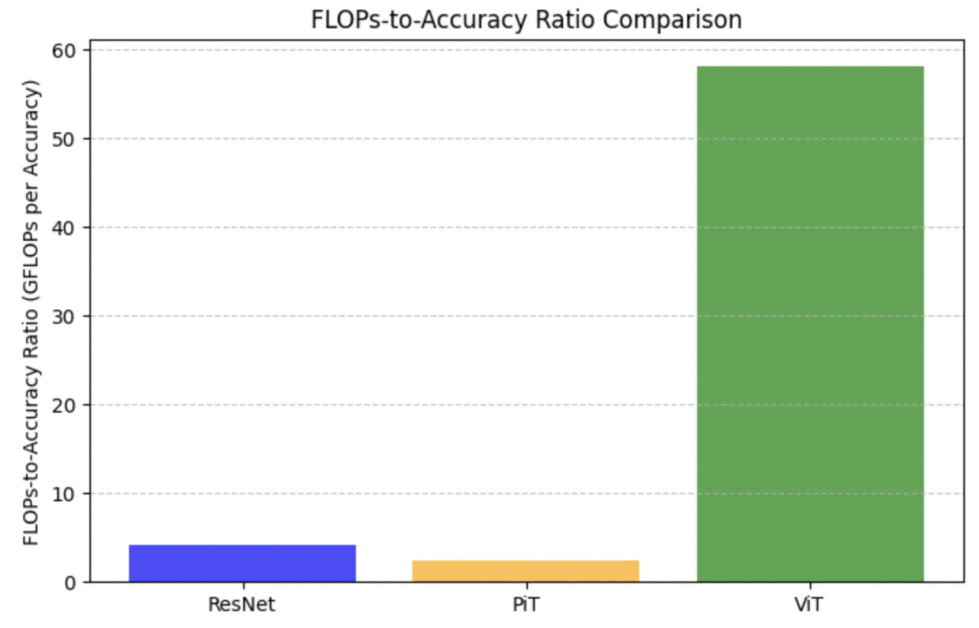
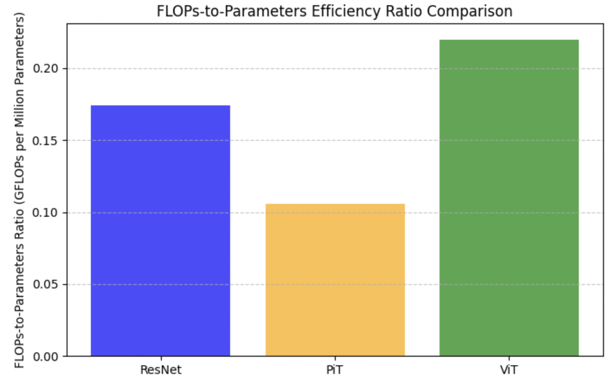
Performance evaluation
3. FLOPS to Accuracy and FLOPS to Parameters Ratio Compression

Slide 18
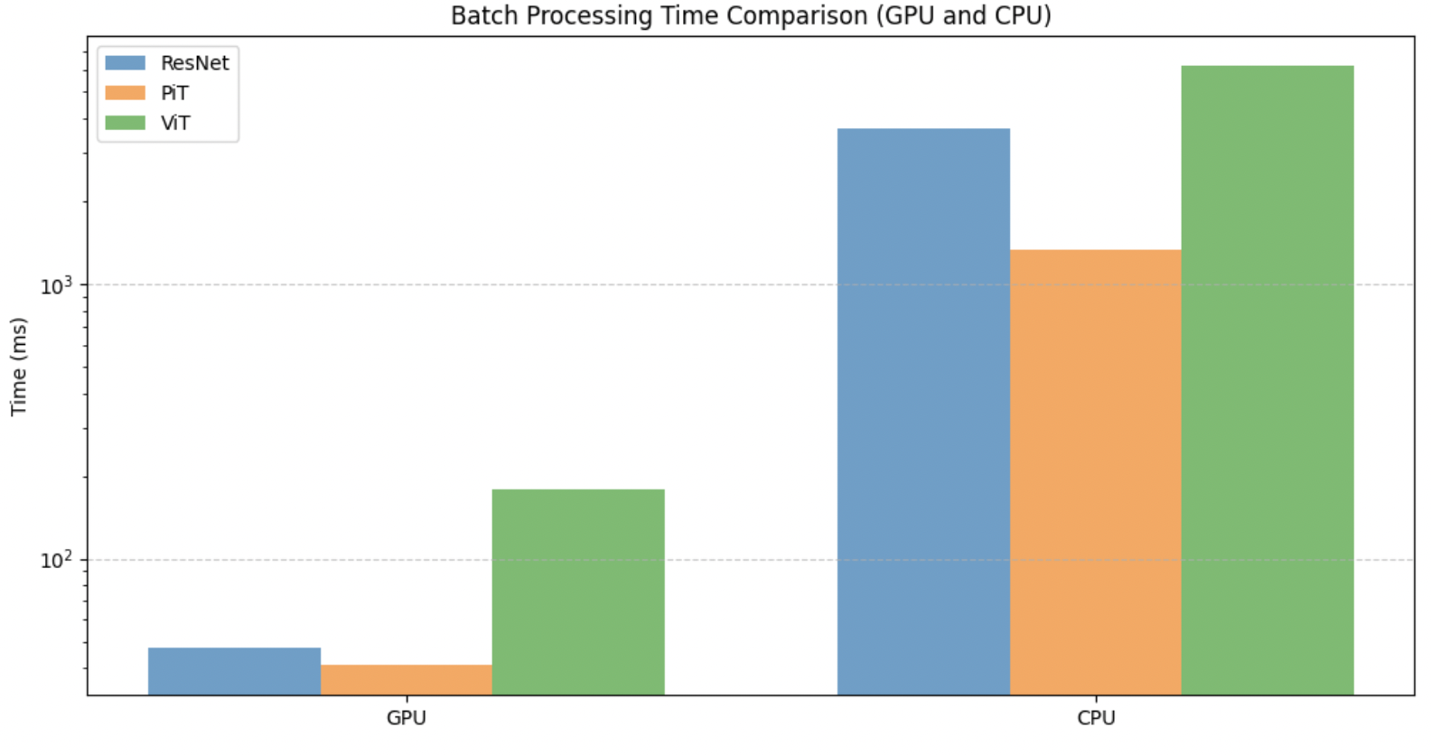
Performance evaluation
4. Batch Processing Time

Slide 19
Discussion
Performance:
PiT and ResNet demonstrate smooth convergence in loss and accuracy, significantly outperforming ViT in terms of both accuracy and reliability.
ResNet achieves slightly better precision and stability, while PiT balances accuracy with computational efficiency.
Generalization:
Both PiT and ResNet exhibit strong generalization, with minimal errors across all 29 plant disease categories.
ViT struggles with generalization due to its reliance on larger datasets or the need for fine-tuning and regularization.
Efficiency:
PiT emerges as the most computationally efficient model, offering a balance between accuracy and FLOPs.
ResNet remains competitive but requires more computational resources compared to PiT.
ViT Limitations:
While ViT has potential, it underperforms on this dataset, highlighting the need for optimization or larger training datasets to achieve comparable performance.
PiT is the most efficient and reliable model for plant disease detection when compared to these three datasets, while ResNet offers slightly higher stability but at a higher computational cost. ViT, although promising, requires further optimization to match the performance and efficiency of PiT and ResNet.

Slide 20
Work Division
Siva Adduri – Literature Review, Training PiT model, Comparative Analysis Results, Presentation Mohamed Alkhaja Alawadhi – Literature Review, Training ResNet model, Video Demonstration, ReadMe file, Project Proposal Writing Arya Sankhe – Literature Review, Training ViT model, Project Proposal Writing, Comparative Analysis Results Hamza Khan – Litertaure Review, Project Proposal Writing, Presentation

Slide 21
Demonstration
Attached video in the submission link

